Slide 1
Tools and Utilities

Slide 2
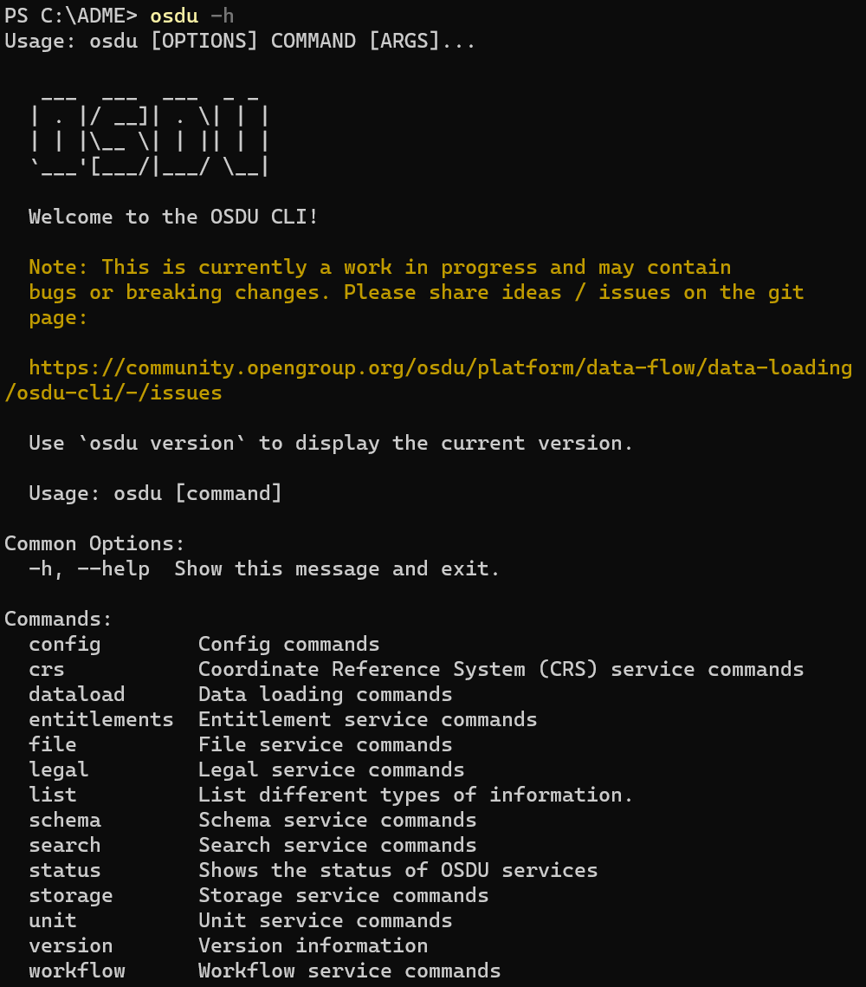
OSDU CLI
Simple interface for efficient management of an OSDU instance.
Source: Open Subsurface Data Universe Software / OSDU Community Utilities / Data Loading / osdu-cli · GitLab (opengroup.org)

Slide 3
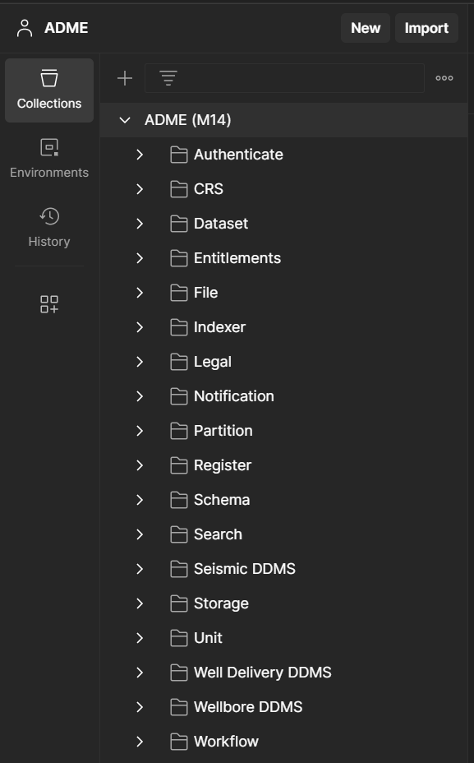
Postman
Powerful and flexible solution for managing all aspects of an OSDU instance.
Postman: https://www.postman.com/downloads/
Full OSDU Collection and Environment: ADME/Guides/Postman Collection at main · EirikHaughom/ADME (github.com)

Slide 4
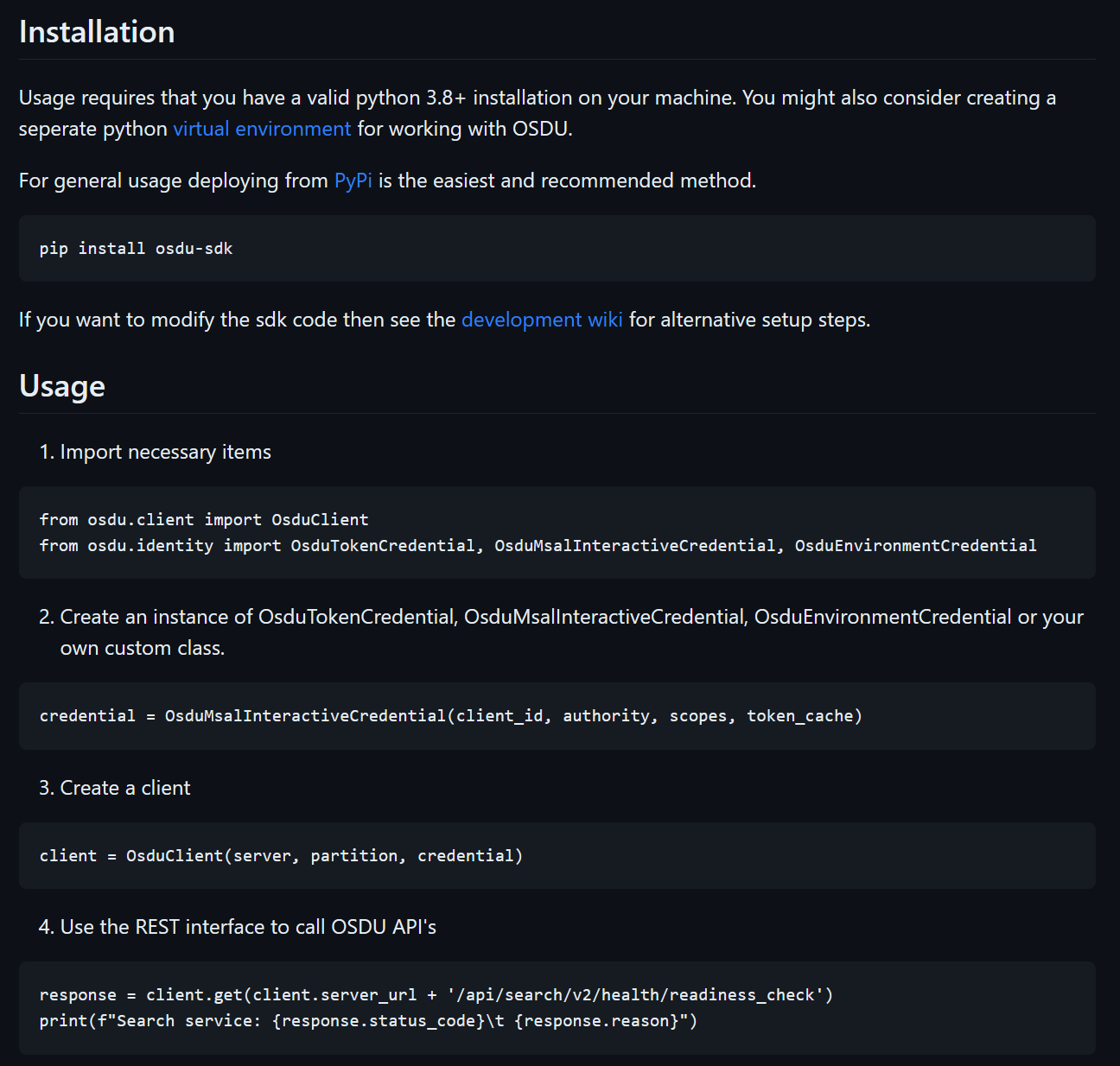
Python SDK
Simplifies authentication and interaction with OSDU APIs through Python code.
Source: equinor/osdu-sdk-python: Python SDK for working with OSDU (github.com)

Slide 5
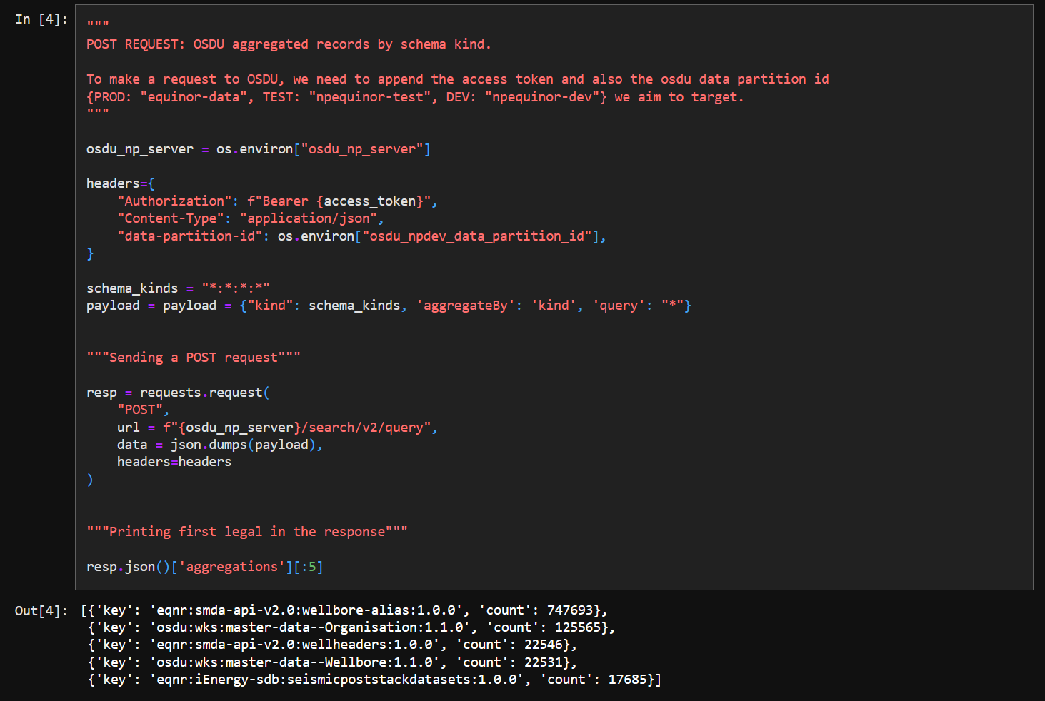
Azure ML Jupyter notebooks
Source: osdu-tutorials/osdu_notebooks at main · equinor/osdu-tutorials · GitHub

Slide 6
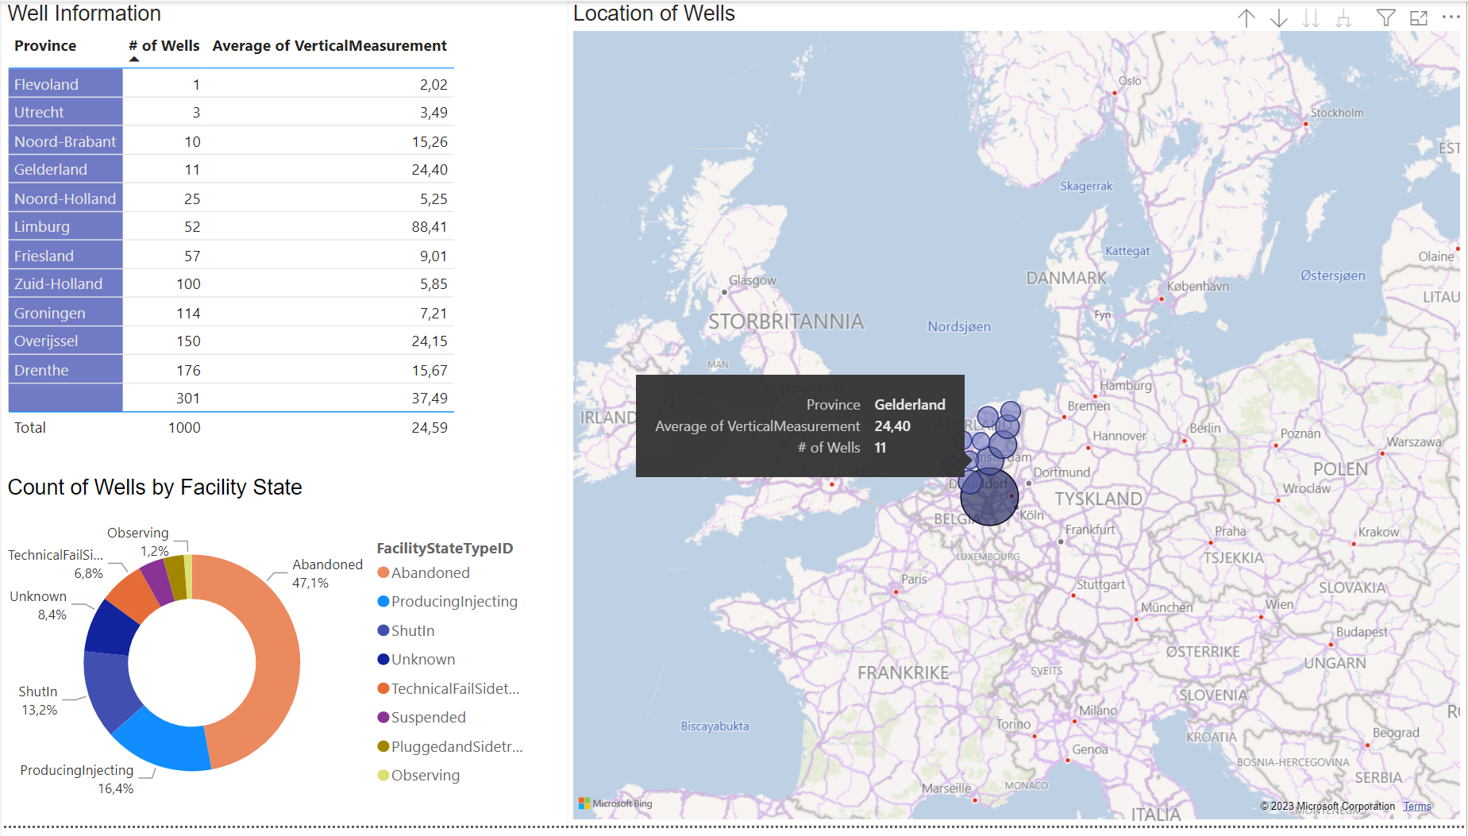
Power BI – Reporting and visualization

Slide 7
Other + 3rd party
Azure Synapse
Azure Data Factory
Spotfire
ESA EarthNet
INT IVAAP
SLB Petrel
SLB SEDS
Halliburton Seismic Engine
AspenTech RMS

